Slide 1

To Senior Leadership & Board of Directors
Cybersecurity Regulatory Requirements
- What you should know about them
- 3 deliverables to request from your security officer

Slide 2

3 Deliverables to Assess Cybersecurity Compliance
REQUEST FROM SENIOR LEADSERHIP TO SECURITY OFFICER
1. Active Cyber Program
2. Asset Inventory Report
3. Security Risk Assessment
4. Optional
Copy of our Cyber Program and the confirmation that it meets the Firm’s cybersecurity regulatory requirements (SEC, FINRA, NYDFS, etc.).
List of evidence confirming the execution of recurring tasks required by regulations.
Copy of our current Endpoint Asset Inventory Report with technical information (serial number, OS version, etc.) and cyber posture (complex password, full-disk encryption, antivirus with endpoint protection and response, computer firewall, etc.).
Copy of an Endpoint Asset Inventory Report dated 1 year ago.
Copy of our latest Security Risk Assessment covering a review of our Cyber Program and a series of technical validation (vulnerability scans, network penetration testing, etc.)
Our current Corrective and Prevention Plan resulting from the Security Assessment.
SEC Mock Exam Exercise
Answer each question of the SEC Mock Exam document published by SEC.
Present the results to Senior Leadership

Slide 3
Cybersecurity Regulatory Requirements
WHAT SENIOR LEADERSHIP AND BOARDS OF DIRECTORS SHOULD KNOW ABOUT
 | SEC | FINRA | NYDFS
Senior Leadership Involvement | ✓ | ✓ | ✓
CISO Nomination | ✓ | Recommended | ✓
Active Cyber Program | ✓ | ✓ | ✓
Asset Inventory Reports | ✓ | ✓ | ✓
Security Risk Assessment | ✓ | ✓ | ✓
Reporting to the Board of Directors | ✓ |  | ✓

Slide 4
Senior Leadership Involvement
CYBERSECURITY REGULATORY REQUIREMENT
SEC
FINRA
NYDFS
1/27/2020 Cybersecurity & Resiliency
“Effective cybersecurity programs start with the right tone at the top, with senior leaders who are committed to improving their organization’s cyber posture through working with others to understand, prioritize, communicate, and mitigate cybersecurity risks.”
Cybersecurity Practices 2015
“Ensuring active senior management, and as appropriate to the firm, board-level engagement with cybersecurity issues.”
6/30/2021 NYDFS Ransomware Guidance
“The Incident Response Plan should be tested, and the testing should include senior leadership – decision makers such as the CEO should not be testing the incident response plan for the first time during a ransomware incident.”

Slide 5
Senior Leadership Involvement
CYBERSECURITY REGULATORY REQUIREMENT
What
Why
How
Governance
CISO nomination
Risk Management
Leading by example
To attract and retain advisors and clients
Preparedness and readiness for exams and breaches
To provide cyber updates and reports to the Board of Directors
To protect
Shareholders
The Firm’s reputation
Themselves
Allocate human and financial resources for cybersecurity
Name a CISO
Personal compliance
Request cyber updates and reports
Participate in annual reviews
Add cyber to agendas
Articulate the Firm’s cyber posture

Slide 6
CISO Nomination
CYBERSECURITY REGULATORY REQUIREMENT
Chief Information Security Officer
SEC
FINRA
NYDFS
9/15/2015 Examination Risk Alert IV.8
“Information regarding the Firm’s Chief Information Security Officer (“CISO”) or equivalent position, and other employees responsible for cybersecurity matters.”
FINRA Contact System (FCS)
“Person at your firm responsible for establishing and maintaining the enterprise vision, strategy and program to ensure information assets and technologies are adequately protected, or person closest to that role.”
3/1/2017 23 NYCRR 500
“Each Covered Entity shall designate a qualified individual responsible for overseeing and implementing the Covered Entity’s cybersecurity program and enforcing its cybersecurity policy.”

Slide 7
Chief Information Security Officer (CISO)
CYBERSECURITY REGULATORY REQUIREMENT
Who
Why
How
An individual (not a committee) with an understanding of both
Cybersecurity regulations and best practices
Safeguard technologies
The role can be outsourced (vCISO) but the responsibility must be retained by a senior leader within the Firm
Lead the Cyber Program development, implementation, enforcement, improvement, and evidencing
Provide cyber updates and reports to Senior Leadership
Empower the CISO with adequate
Leadership support
Human and financial resources

Slide 8
CISO Job Description
CYBERSECURITY REGULATORY REQUIREMENT
Develop and implement an effective Cyber Program that aligns with business objectives and regulatory requirements.
Establish and maintain security policies, procedures, and standards to safeguard sensitive data, systems, and networks.
Conduct regular risk assessments and vulnerability assessments to identify potential security threats and recommend mitigation strategies.
Monitor and respond to security incidents and breaches promptly, ensuring appropriate actions are taken to contain and resolve issues.
Collaborate with IT, Cyber, and business units to ensure security measures are integrated into business processes and technology solutions.
Implement security awareness training for employees to promote a culture of cybersecurity awareness and best practices.
Evaluate and select security technologies and tools to enhance the firm's security infrastructure.
Oversee third-party vendor risk assessments and ensure compliance with security requirements.
Stay informed about industry trends, emerging threats, and best practices to proactively address security challenges.
Prepare and present security reports to Senior Leadership, providing insights on security performance and areas of improvement.

Slide 9
Active Cyber Program
CYBERSECURITY REGULATORY REQUIREMENT
SEC
FINRA
NYDFS
1/27/2020 Cybersecurity & Resiliency
“Adopt and implement written policies and procedures reasonably designed to prevent violations of the Advisers Act and rules thereunder.”
Cybersecurity Practices 2015
“The identification, selection, implementation, performance monitoring, and updating of the controls firms use in their cybersecurity programs.”
3/1/2017 23 NYCRR 500
“Maintain a cybersecurity program designed to protect the confidentiality, integrity, and availability of the Firm’s Information Systems.”

Slide 10
Active Cyber Program
CYBERSECURITY REGULATORY REQUIREMENT
What
Why
How
Security policies, procedures, and controls
Definition
Implementation
Monitoring
Revision
Tracking
Improvement
To ensure the confidentiality, integrity, and availability of Nonpublic Information (NPI)
To meet Cybersecurity Regulatory requirements that applied to the Firm
Identify cyber regulations and develop a Cyber Program to meet their requirements
List tasks associated with the Cyber Program
Track the execution of these tasks
Coordinate a Corrective & Prevention Plan
Perform annual review and approval with Senior Leadership

Slide 11

Active Cyber Program
CYBERSECURITY REGULATORY REQUIREMENT
Main Modules
Risk Management & Assessment
Information Security Policy
Business Continuity & Disaster Recovery Plan
Security Incident Response Plan
Vendor Risk Management
Acceptable Use Policy
Cybersecurity Awareness Training & Phishing Campaigns
Corrective & Prevention Plan
What to ask your team
Copy of the Firm’s Cyber Program and the confirmation that it meets the Firm’s cybersecurity regulatory requirements
List of evidence confirming the execution of recurring tasks associated with the Cyber Program

Slide 12
Asset Inventory Reports
CYBERSECURITY REGULATORY REQUIREMENT
SEC
FINRA
NYDFS
1/27/2020 Cybersecurity & Resiliency
“Maintaining an inventory of hardware and software assets, including identification of critical assets and information (i.e., know where they are located, and how they are protected).”
Cybersecurity Practices 2015
“An inventory of hardware and software assets, including all personal and firm devices used to access firm systems and data.”
3/1/2017 23 NYCRR 500
“An asset inventory and device management policy shall be implemented and maintained.”

Slide 13
Asset Inventory Reports
CYBERSECURITY REGULATORY REQUIREMENT
What
Why
How
List of assets and the evidence of their compliance with the Firm’s Cyber Program
Systems
Software
Data
Users
Endpoints
Networks
Locations
For compliance verification
As evidence during and exam or a breach
for Lifecycle management (onboarding and decommissioning)
For vendor management and approved vendors list
Leverage automation to avoid human errors
Produce columnar reports for quick and easy reference
Keep versions in time for further reference during breaches

Slide 14
Asset Inventory Reports
CYBERSECURITY REGULATORY REQUIREMENT
Assets
Systems
Software
Data
Users
Endpoints
Networks
Locations
Ask your team
Copy of the Firm’s latest Asset Inventory Reports
Copy of an Endpoint Asset Inventory Report dated 1 year ago

Slide 15
Security Risk Assessment
CYBERSECURITY REGULATORY REQUIREMENT
SEC
FINRA
NYDFS
1/27/2020 Cybersecurity & Resiliency
“Risk assessment to identify, analyze, and prioritize cybersecurity risks to the organization.”
8/7/2017 Observations Risk Alert VI.5 “Vulnerability scans of infrastructure required to aid in identifying potential weaknesses in a Firm’s key systems.”
Cybersecurity Report 2018
“Conduct annual risk assessments and testing of firm controls to verify effectiveness and adequacy. This assessment may be accomplished using third-party or firm security experts.”
3/1/2017 23 NYCRR 500
“Companies should have a documented program to identify, assess, track, and remediate vulnerabilities on all enterprise assets within their infrastructure and include periodic penetration testing.”

Slide 16
Security Risk Assessment
CYBERSECURITY REGULATORY REQUIREMENT
What
Why
Ask your team
Copy of the latest Security Risk Assessment with its Corrective and Prevention Plan
Annual review of Cyber Program’s Policies and Procedures and the evidence that tasks associated with them are performed
Annual vulnerability scans and network penetration testing to identify potential weaknesses or security flaws
Corrective and Prevention Plan to address the results
Help the Firm to proactively address security issues and strengthen its overall cybersecurity posture

Slide 17
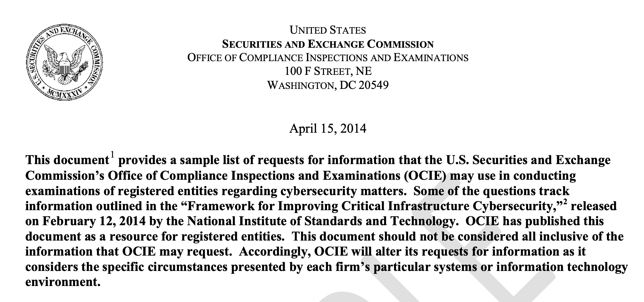
Mock SEC Exam
CYBERSECURITY REGULATORY REQUIREMENT
Assets
To aid organizations in exam preparation, the SEC has released a sample of questions typically posed to firms.
Ask your team
Answer each question of the SEC Exam sample
Present results to Senior Leadership

Slide 18
Reporting to the Board of Directors
CYBERSECURITY REGULATORY REQUIREMENT
SEC
FINRA
NYDFS
1/27/2020 Cybersecurity & Resiliency
“Responding promptly to testing and monitoring results by updating policies and procedures to address any gaps or weaknesses and involving board and senior leadership appropriately.”
Cybersecurity Practices 2015
“At a number of firms, the board receives annual cybersecurity-related reporting while other firms report on a quarterly basis. A number of firms also provide ad hoc reporting to the board in the event of major cybersecurity events.”
3/1/2017 23 NYCRR 500
“The CISO of each Covered Entity shall report in writing at least annually to the Covered Entity’s board of directors or equivalent governing body.”

Slide 19
Reporting to the Board of Directors
CYBERSECURITY REGULATORY REQUIREMENT
What
Why
How
Material risks
Overall effectiveness of the Cyber Program
Security event and breaches
Cybersecurity-related matters involving vendors
To protect
Shareholders
The Firm’s reputation
Themselves
Request cyber updates and reports
Maintain accurate meeting minutes when addressing cybersecurity topics

Slide 20
During a security exam or a breach, will you be considered compliant or negligent?

